Slide 1
Credit worthiness– final project

Slide 2
Credit worthiness
The analysis is aimed to determine the probability of a loan defaulting due to factors collected in the data. Our team secured the dataset from Kaggle, cleaned the dataset, built a regression model, and created an interactive (HTML) user interface (UI) to get predictions. The HTML page allows users to see the predictions of the model. Due to the limitations within the dataset, our evaluation is limited. This report outlines the limitations of the data and an overview of our analysis.

Slide 3
The analysis
The analysis is organized into the following sections:
Data
Exploration of the dataset.
Data cleaning and preparation processes.
Feature engineering to enhance predictive performance.
Machine Learning Model
Regression model used to predict loan defaults.
Evaluation metrics such as accuracy and R-squared.
Insights derived from the model.
HTML Page
Interactive interface designed to generate loan default predictions.
User-friendly layout for entering input data and viewing predictions.
Conclusion
Summary of findings and insights.
Identified limitations in the dataset.
Recommendations for improving the analysis in the future.

Slide 4
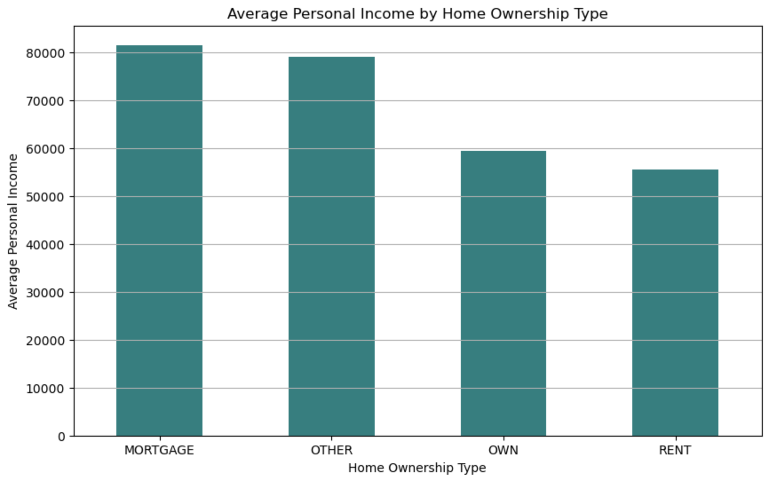
visuals

Slide 5
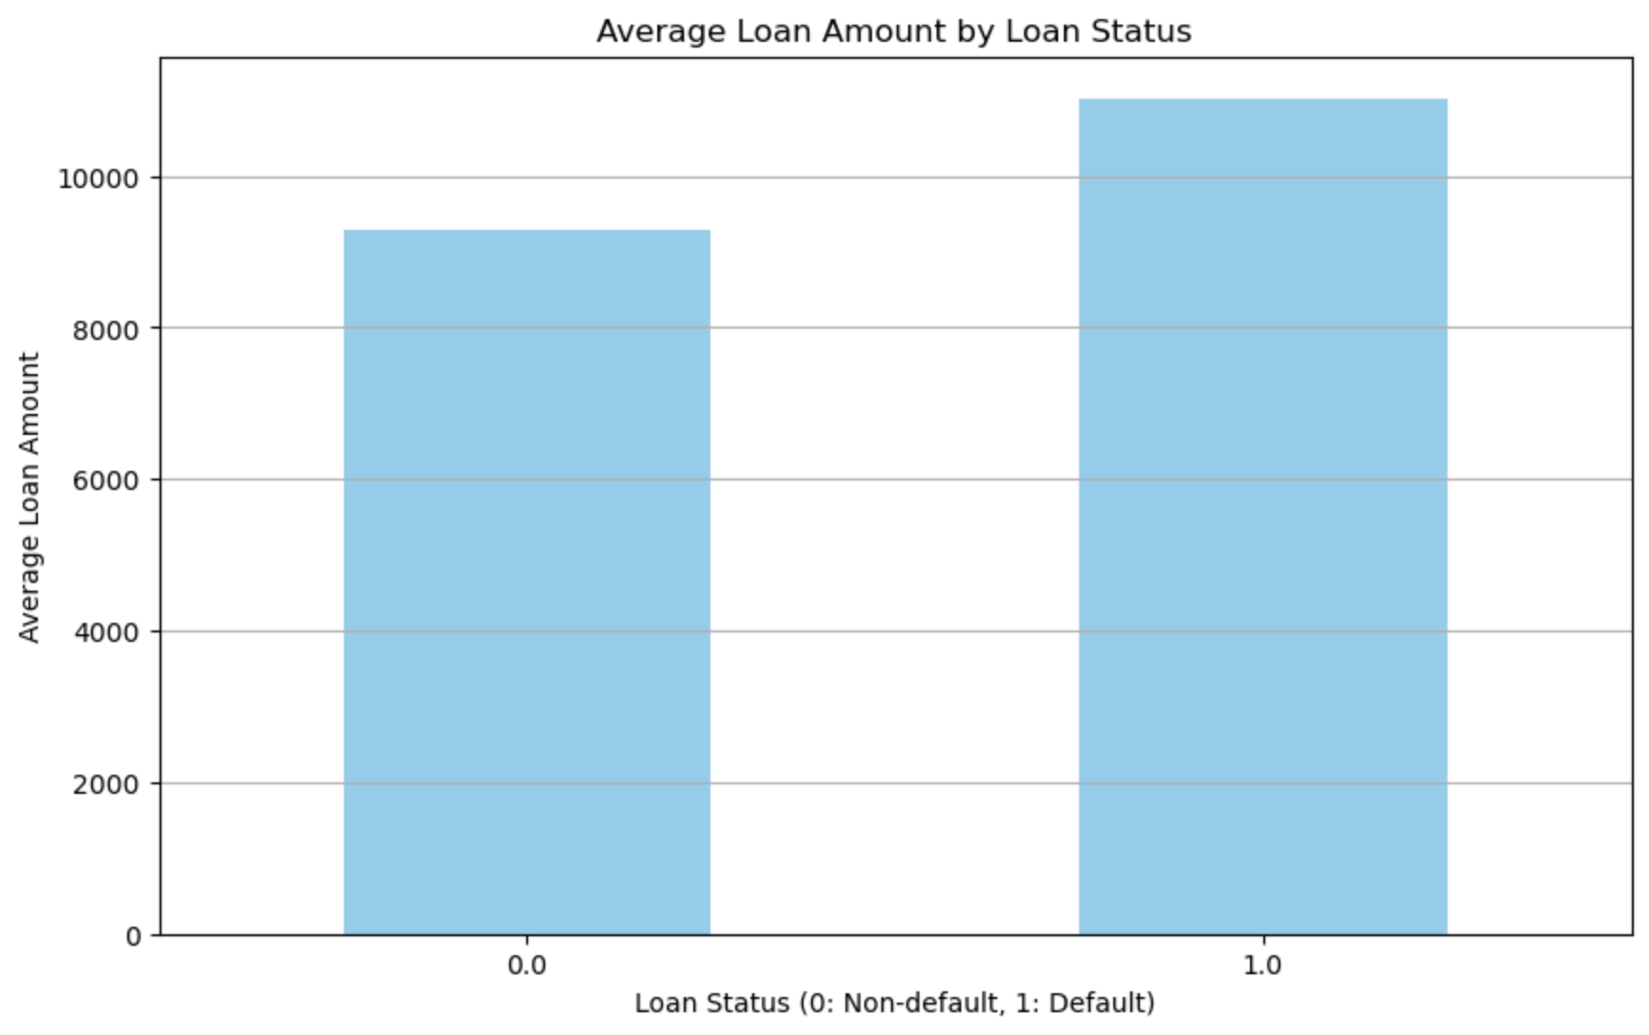
visuals

Slide 6
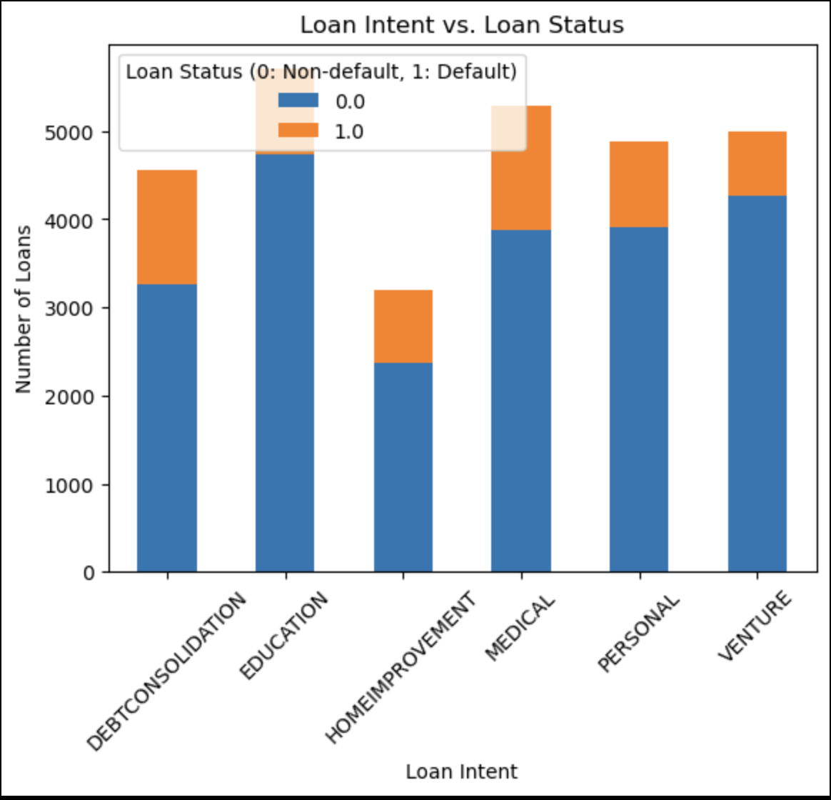
visuals

Slide 7
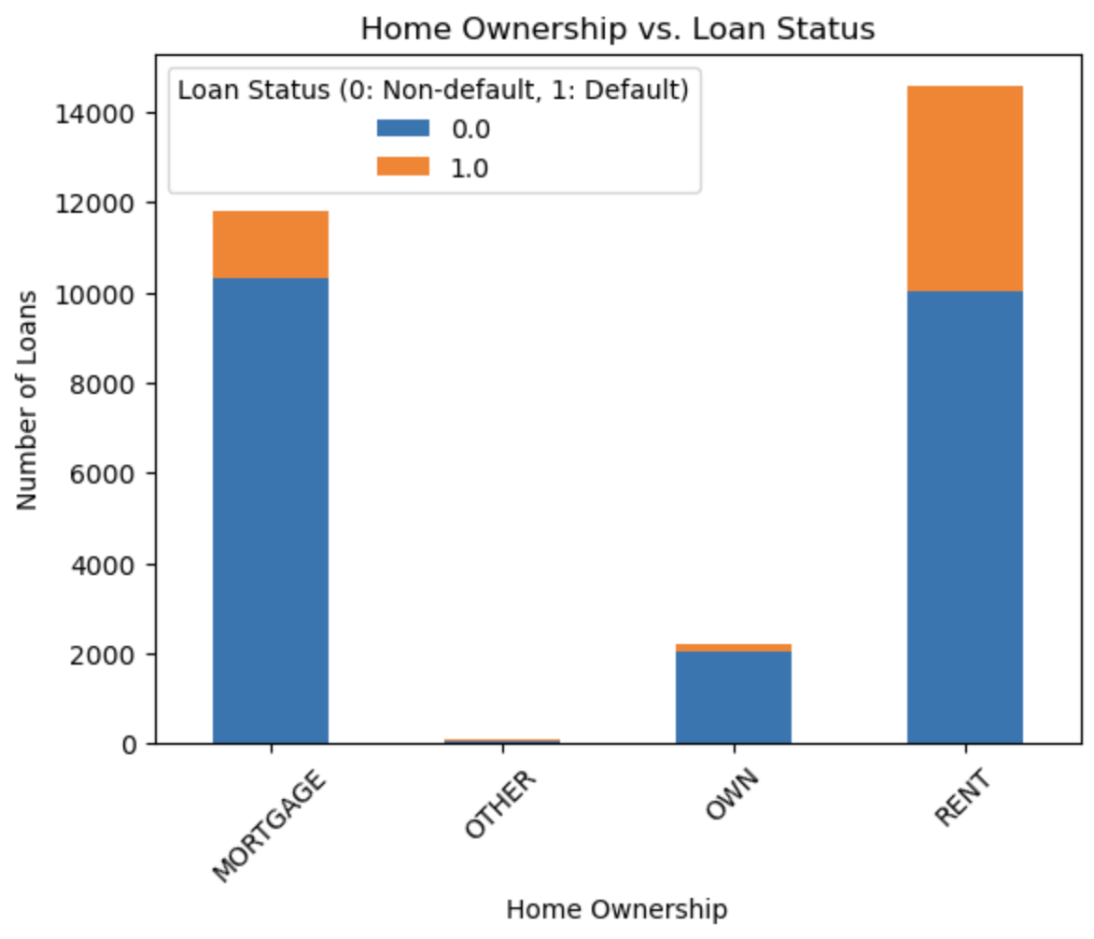
visuals

Slide 8
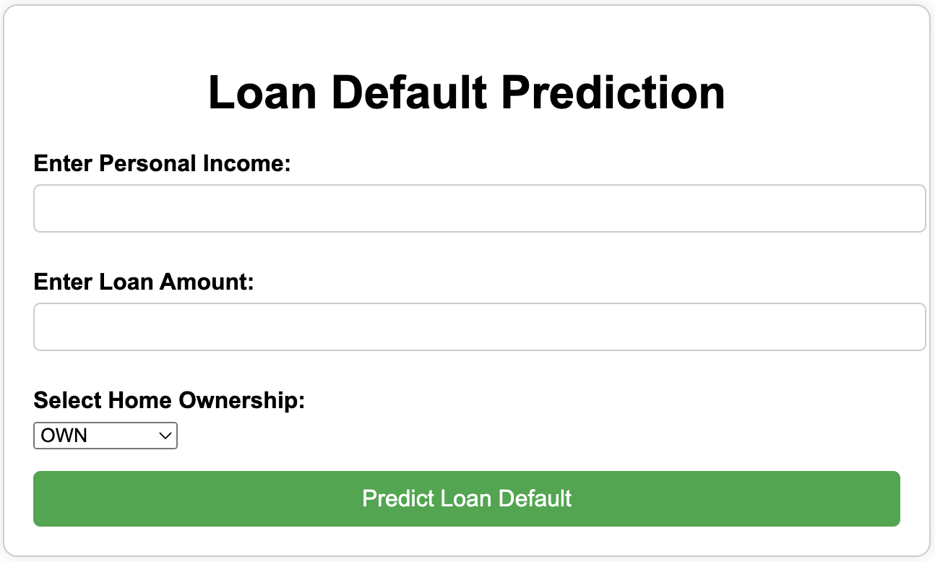
Html page

Slide 9
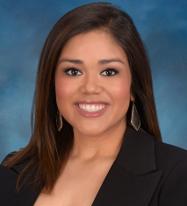

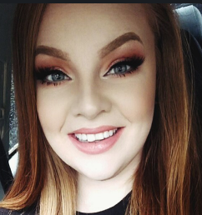


Contributors
Ashley Charles
Azania Hood-Hosten
Leah Mathena
Sarah Sherry
Vanessa Ivarra

Slide 10
Thank you

